Slide 1
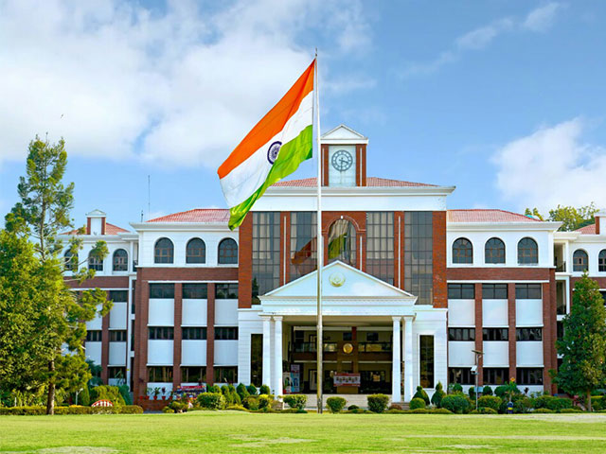



4th International Conference On Innovative Sustainable Computational Technologies
27-28 December 2024, GEIMS, Dehradun
Organized by Dept. of Computer Science & Engineering
Graphic Era deemed to be University Dehradun

Slide 2
bvbvbvbvbContents
Abstract
Introduction
Literature Survey
Problem Definition
Proposed Work
Methodology & Implementation
Results & Discussions
Conclusions
References

Slide 3
Abstract

Slide 4
Introduction

Slide 5
Literature Survey

Slide 6
PProblem Definition

Slide 7
Proposed Work

Slide 8
Methodology & Implementation

Slide 9
Results & Discussion

Slide 10
CConclusion

Slide 11
References

